Slide 1
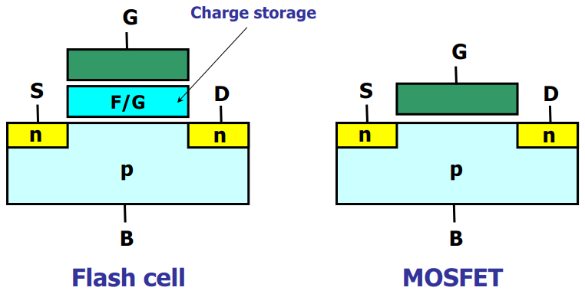
Flash memory cell vs. MOSFET
Flash cell has a charge storage layer such that Vth of cell can be changed → memorize the information

Slide 2
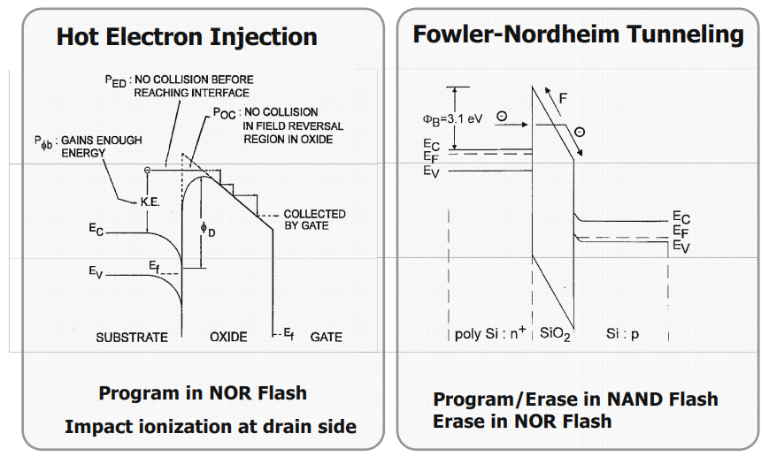
Write methods in Flash Memory

Slide 3
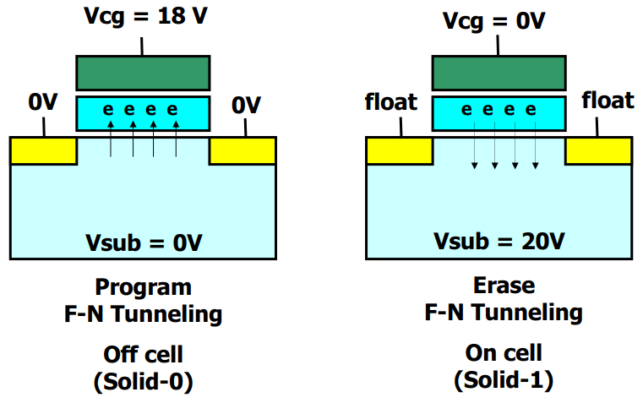
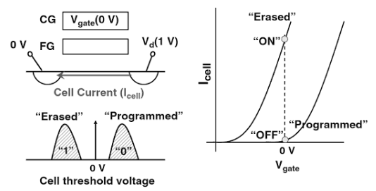
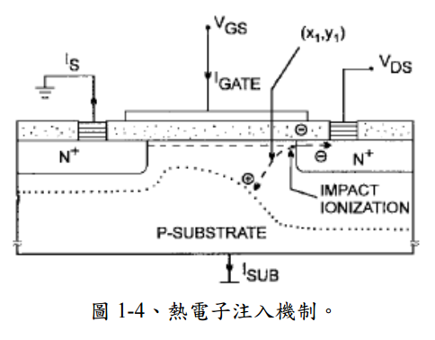
NAND flash: program & erase
F-N injection
Channel hot electron injection

Slide 4
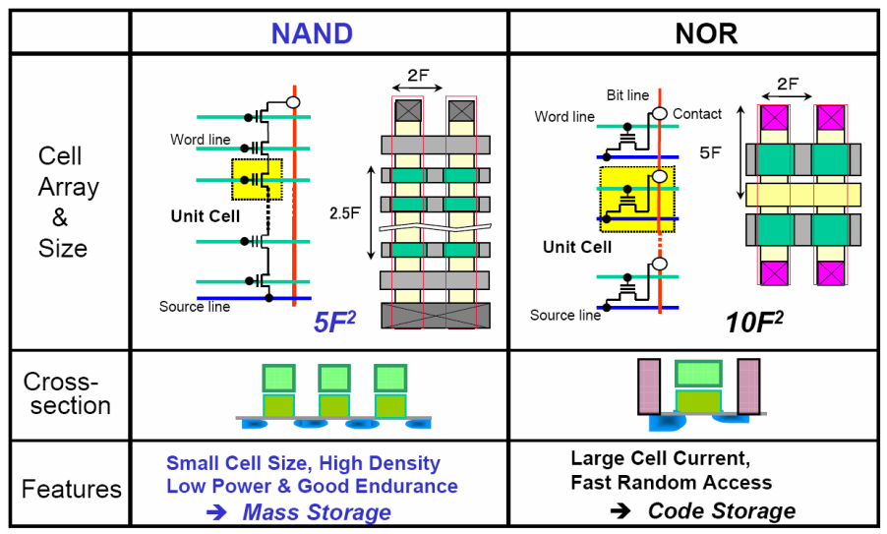
NAND vs. NOR
Notes:
這裡是nand和nor的比較，我們可以發現nor天生就比較大顆，一個cell就要打一個contact
source/drain implant又要特別處理因為program是CHEI參雜方式不同
nand 的話則是32cell or 64 cell 打一個contact 所以nand相較nor更是微縮
再來是耗電 nor 又比nand 更耗電，一來是read current大，再來是program是CHEI
這是一種沒有效率的program方式大部分電流都漏掉了，
也因為這樣它的pumping電路需要考慮power可不可以supply
如果沒設計好circuit就容易crash
nand的部分FN雖然電流小program很慢，但應為一次program一個page所以有速度上的優勢
當然就read而言，nor可以很快 因為random access nand沒辦法只能循序讀
這使得他們在應用上走不一樣的路，nand負責mass stroage nor 負責 code storage

Slide 5
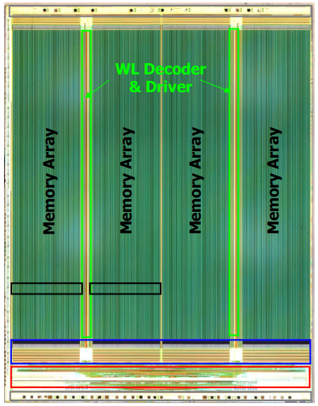
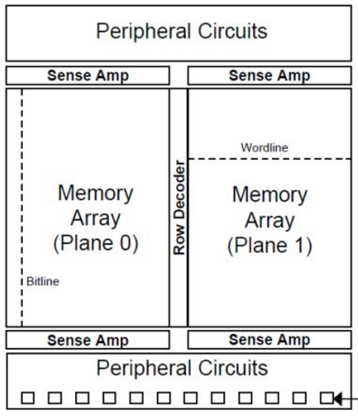
NAND flash chip architecture
block
=256/64 pages (mlc/slc)
Page buffer & S.A.
Peripheral & charge pump (HV)
Mlc: 128WLs , 16KB BLs
Slc: 32WLs , 32768 BLs
DATA IO pad

Slide 6
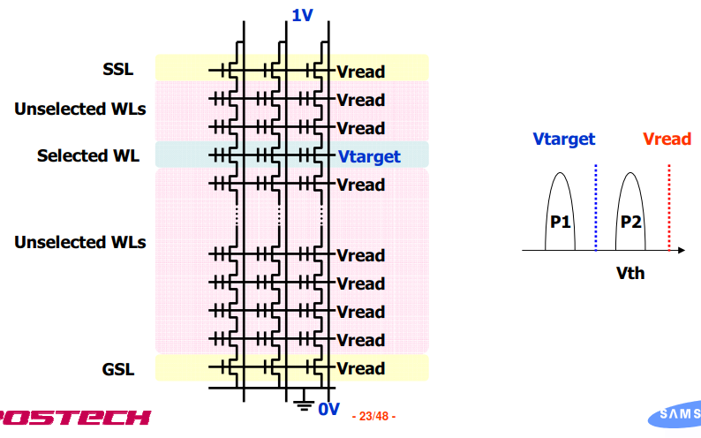
Read
SSL: String Select Line
GSL: Ground Select Line
(VpassR)

Slide 7
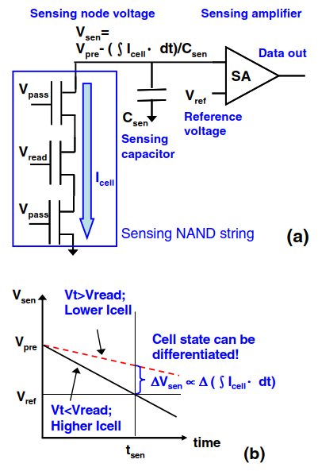
Read
Read step:
Precharge
Developing (sensing)
Data latch
Sensing level

Slide 8
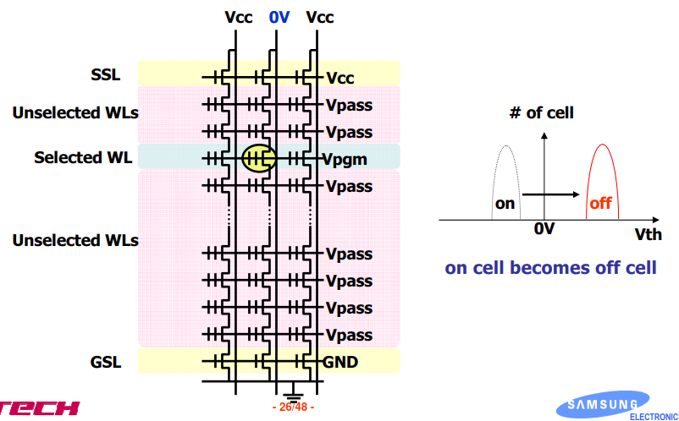
Program
(VpassP)

Slide 9
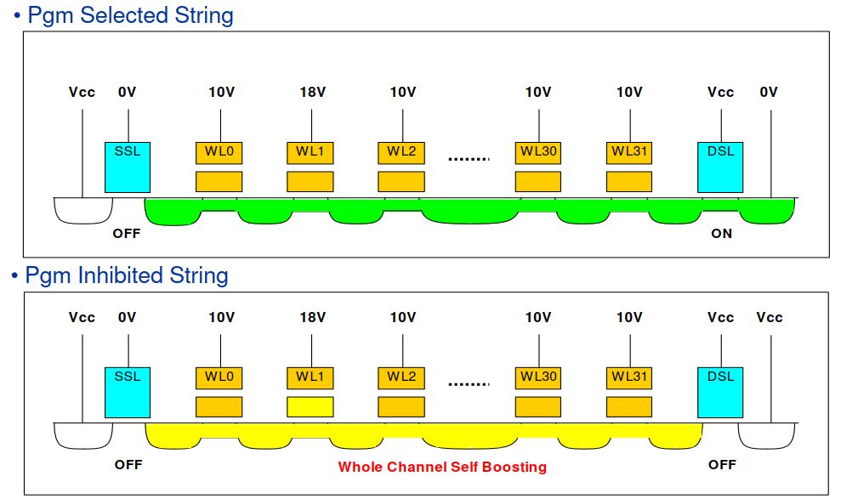
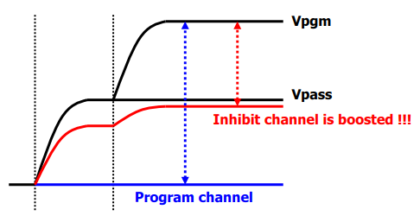
Program
Vch=Vcc-Vth(DSL) ➔ cutoff (DSL off)
Vch=Vcc-Vth + αVpass
Vch=Vcc-Vth + αVpass + βVpgm

Slide 10
n
n
n
n
n
p
p
0
0
n
0
0
0
0
n
n
n
n
p
p
2
2

Slide 11
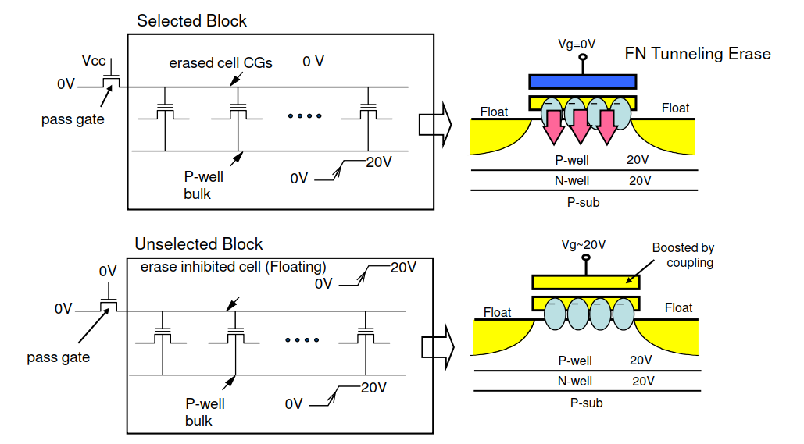
Erase

Slide 12
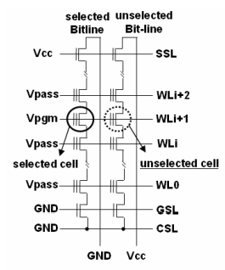
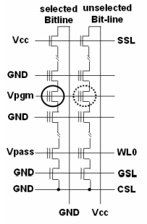
Self-Boosting Program Inhibition: SBPI
Global self-boosting
Local self-boosting
LSB:
Can the pgm string pass 0V as Vio is GND?
Is the program-order algorism still workable in LSB?
LSB ~ EASB?
0
7
18
7
0
Why we need to use local self-boosting?

Slide 13
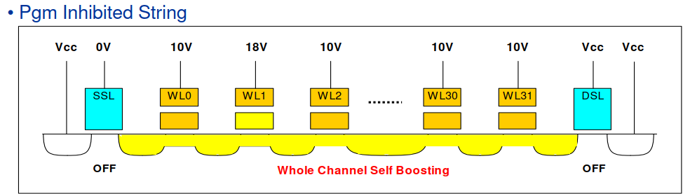
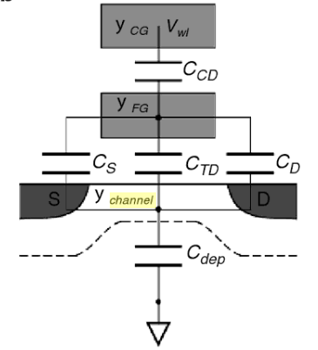
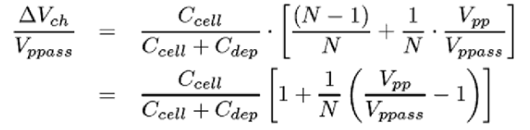
Self-Boosting Program Inhibition: SBPI
Boosting potential is dependent on Cdep and N.
Cdep ↓ ➔ dVch ↑
N ↑ (32 -> 64 WLs)➔ dVch ↓
Cdep ↓ (cell punch) , junction doping ↑ ➔ leakage
Notes:
為何要用local self boosting
這個是channel boosting 的效率，這邊可以發現它跟substrate電容還有串接cell的數量有關
這裡告訴我們電容愈小愈好，所以濃度要愈低愈好，另外串接的數量也要愈少愈好
然而這跟scaling相反。因為我們會希望串接的cell數可以增加，目前已從32WL ==> 64 WL
所以這會影響我們的boosting potential，因為如此所以我們把channel濃度調很淡。
然而這又會造成GSL關不緊產生leakage。另外由於BL跟BL之間愈來愈靠近，這也變成BL方向leakage的來源。
因為這些原因所以我們需要改成local self boosting

Slide 14
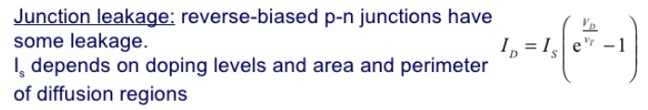

Self-Boosting Program Inhibition: SBPI
8V
SSL punch
Junction leakage
Number of cells in the string
SSL subthreshold current
S/D junction leakage
BL to BL coupling

Slide 15
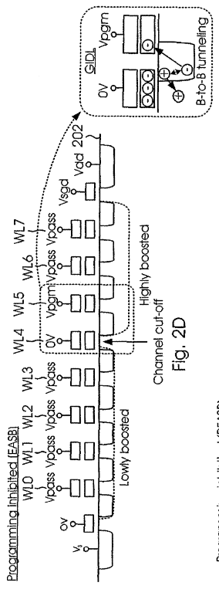
Self-Boosting Program Inhibition: SBPI
EASB
It improves SSL GIDL
The erase area could be boosted higher than the program area.

Slide 16
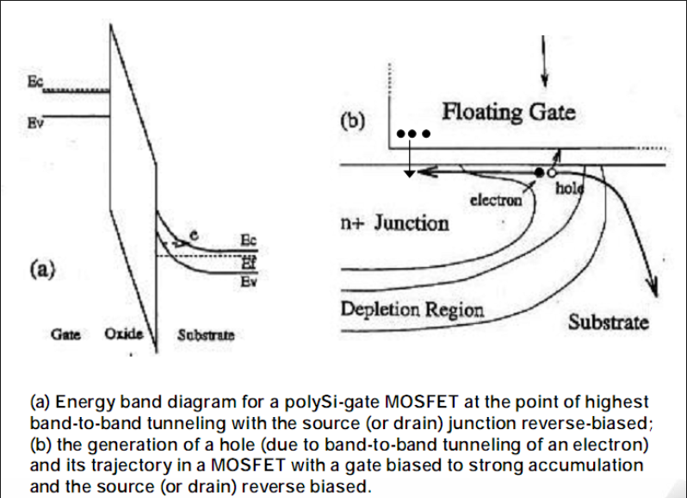
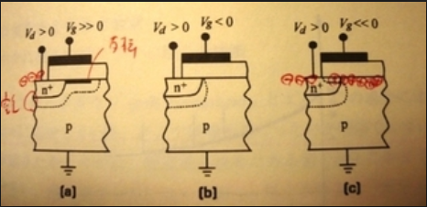
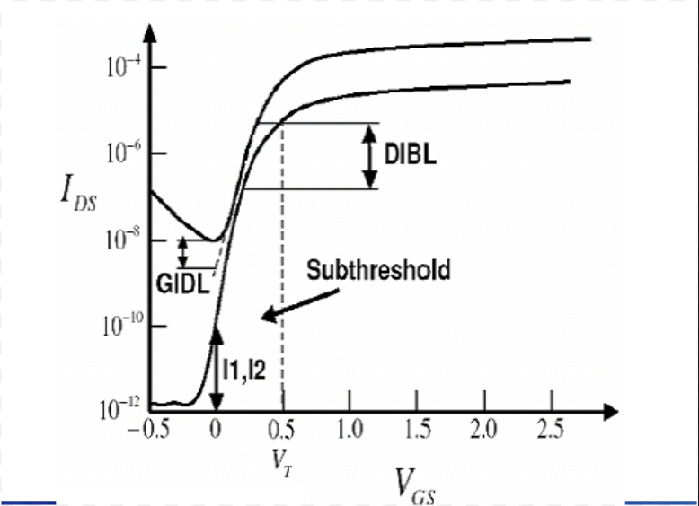
Gate-induced drain leakage (GIDL)
-- additional --
MOS device: acc. => dep. => inv.
The narrowing of the depletion layer at or near the intersection of the p-n junction and Si-SiO2 interface causes field crowding.
hole
E
-
P
+
N
-
+
electron

Slide 17
Gate-induced drain leakage (GIDL)
-- additional --
P-type
n-type
hole
E
-
P
+
N
-
+
electron
Depletion width

Slide 18
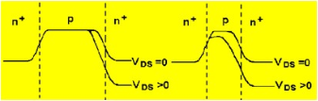
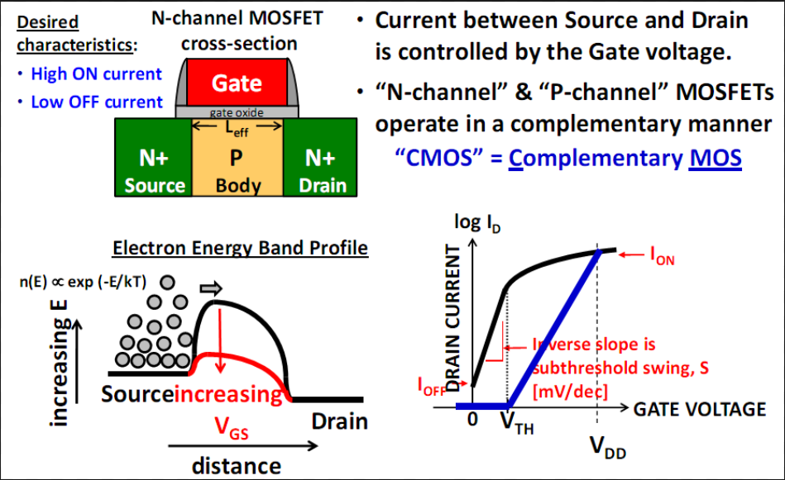
Drain-induced barrier lowing (DIBL)
-- additional --

Slide 19
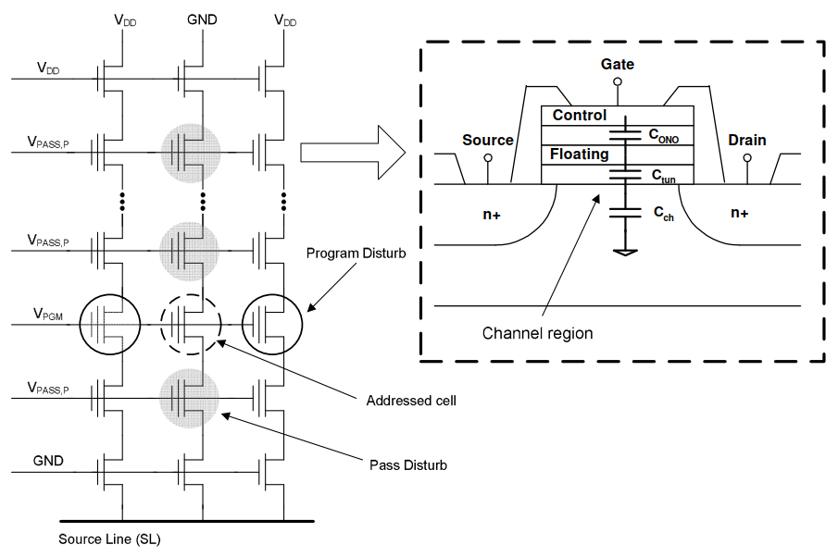
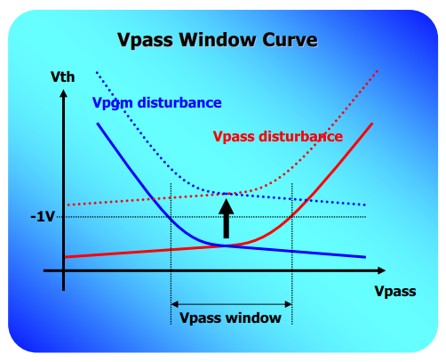
Program disturb
32wls
WL->
BL ->

Slide 20
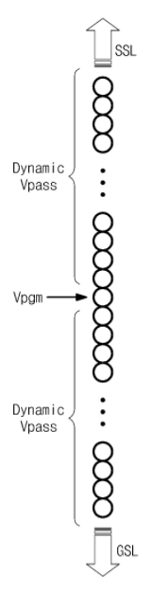
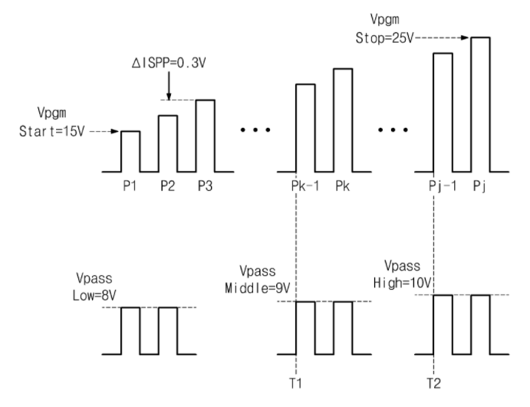
Program disturb
How to improve Vpassp disturbance?

Slide 21
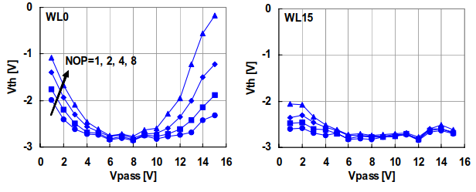
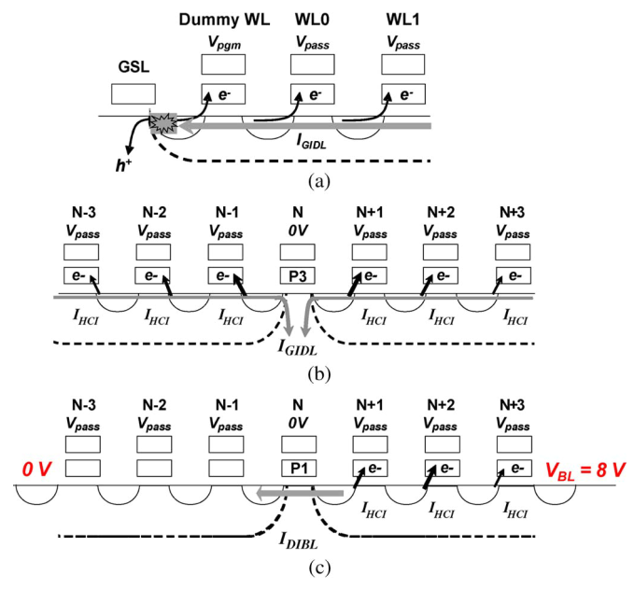
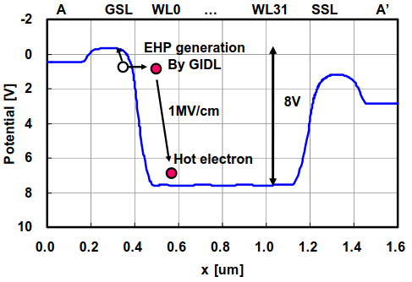
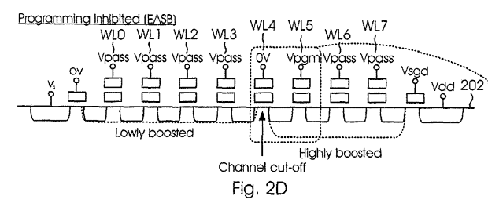
Program disturb
Vpgm
Vpgm

Slide 22
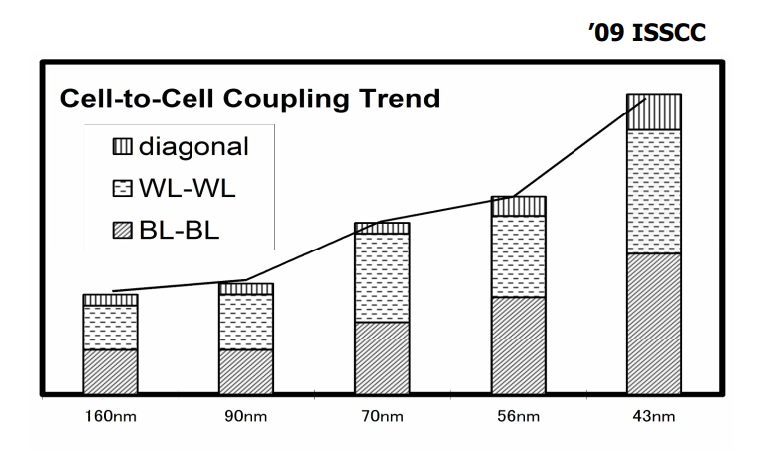
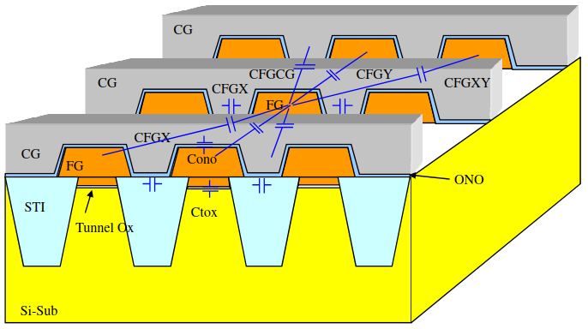
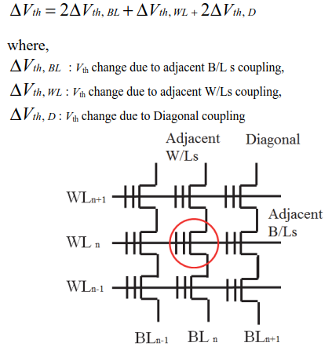
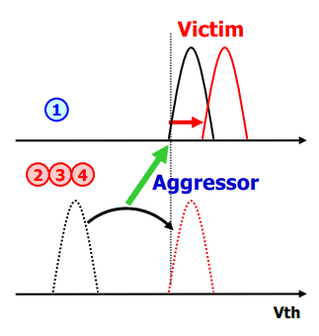
Cell-to-cell interference
Poly floating NAND
WL
BL
* 3Xnm Interfernce ~ 100~150mV/V
4
3
4
2
2

Slide 23
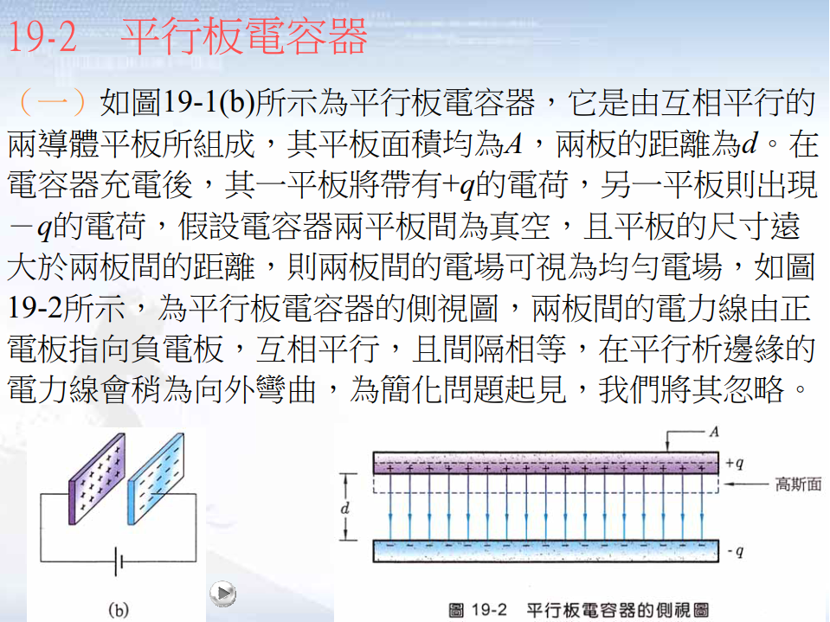
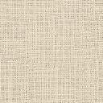
Cell-to-cell interference
Air-gap

Slide 24
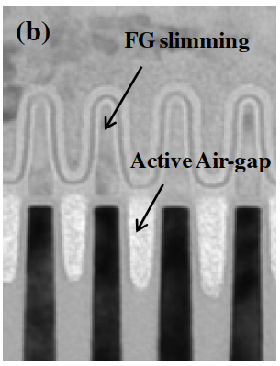
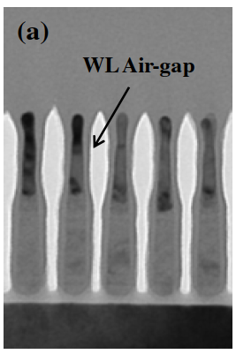
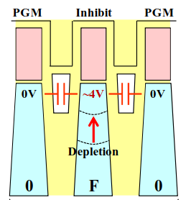
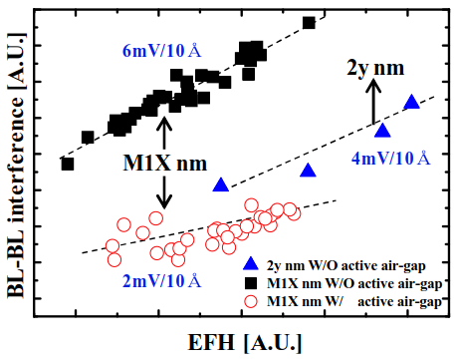
Cell-to-cell interference
Air-gap
BL2BL
WL2WL
EFH
8V
WL air-gap diminishes coupling between WLs
Air~1
SiO2~3.9

Slide 25
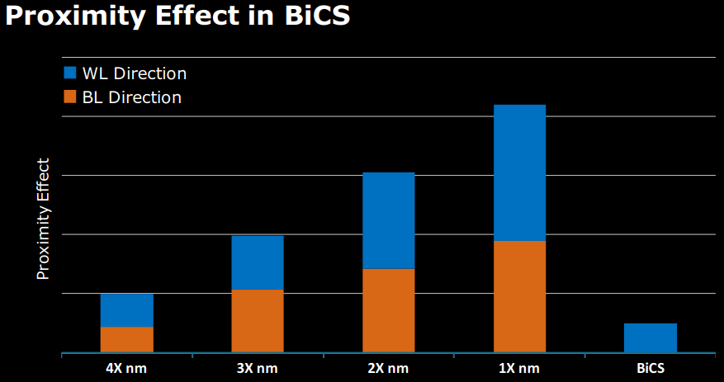
Cell-to-cell interference
Nitride based NAND

Slide 26
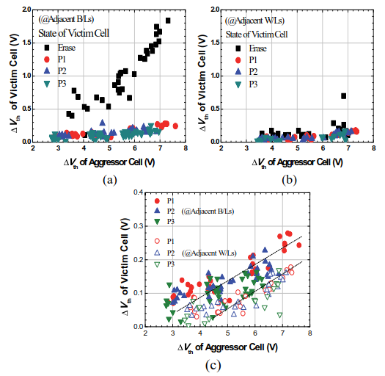
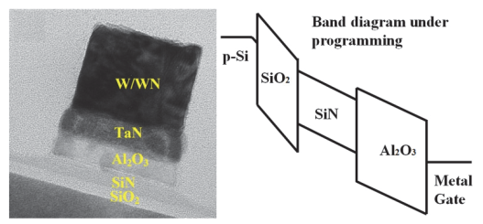
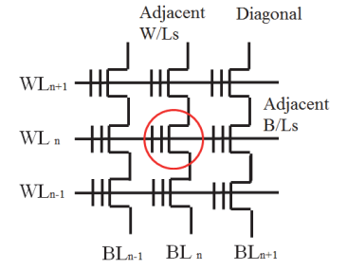
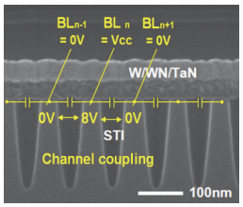
Cell-to-cell interference
Nitride based NAND
In order to reduce the channel coupling, the pair-bit program would be necessary.

Slide 27
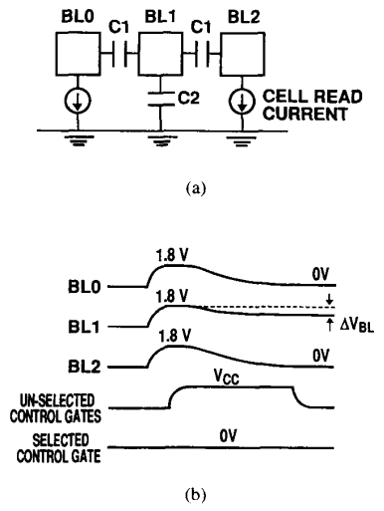


Sensing
BL-to-BL coupling noise
Common source line (CSL) noise
ers
target
pgm
w/o noise
BL
w/ noise
WL
…
…
…
…
Induced by BL coupling
Induced by CSL

Slide 28

Sensing
Conventional is an Even / Odd architecture
One Sense Amplifier handling two Bit Lines
Every other Bit Line shielded during sensing
Full READ and PROGRAM capabilities for ABL
No shielding necessary (it’s current mainstream NAND architecture)
It has to use with current sensing together

Slide 29

What is CTF?
CTF (Charge trap flash)
SONOS type flash memory
Electron is trapped in nitride trap layer
ONO

Slide 30

Floating gate vs. SONOS

Slide 31



3D Charge Trap NAND
Advantage:
SONOS type structure => easy scaling
Full depleted SOI => good channel boosting
GAA => good gate control
Junction free process => suppress cell punch
Nitride layer => interference immunity

